Slide 1
Lead Scoring Case Study
1
Ganesh Balaji, Siva Sankar, Anwita Ghosh

Slide 2
Problem Statement
2
An education company named X Education sells online courses to industry professionals. The company markets its courses on several platforms and websites. While surfing through the website the customers are prompted to enter their credentials which are classified as leads. Once the company acquires enough leads it deploys its Sales team to acquire them. Over the past few years, X Education has observed a decline in their lead conversion.
X Education has appointed us to help them select the most promising leads, i.e. the leads that are most likely to convert into paying customers. The company requires us to build a model wherein we need to assign a lead score to each of the leads such that the customers with a higher lead score have a higher conversion chance

Slide 3
Solution Methodology
3
Workflow Overview
Load the dataset and explore the structure of the DataFrame
Prepare the data for analysis
Perform Exploratory Data Analysis (EDA)
Create dummy variables for categorical features
Split the dataset into training and testing sets
Apply feature scaling to standardize the data
Analyze feature correlations
Build the model using techniques such as RFE, R- squared, VIF, and p-values
Evaluate the performance of the model
Generate predictions on the test dataset

Slide 4
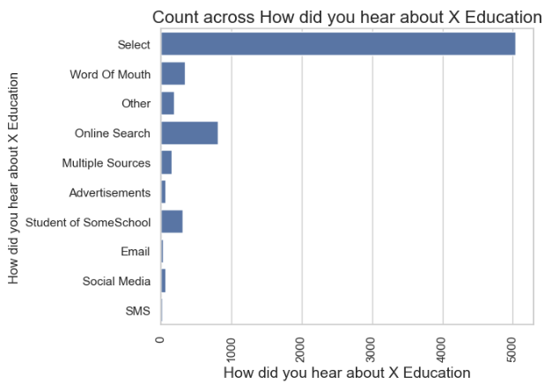
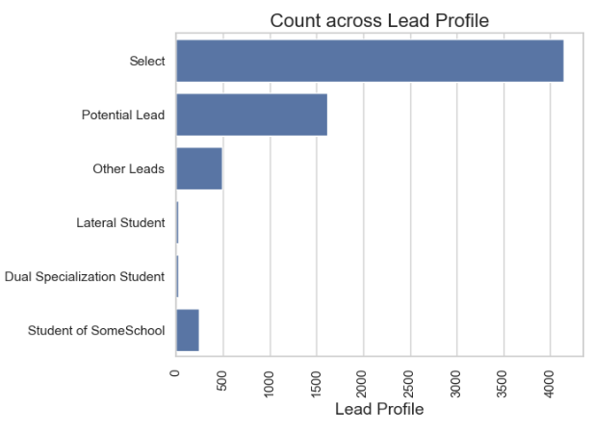
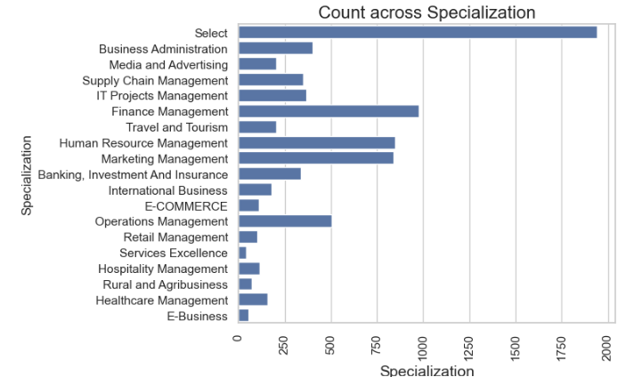
Exploratory Data Analysis
4
We’ve seen some columns with ‘Select’ as a category

Slide 5
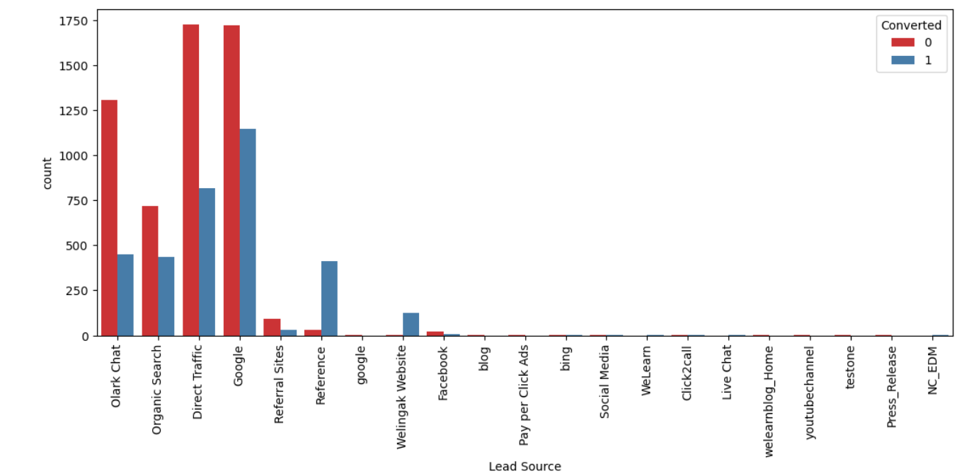
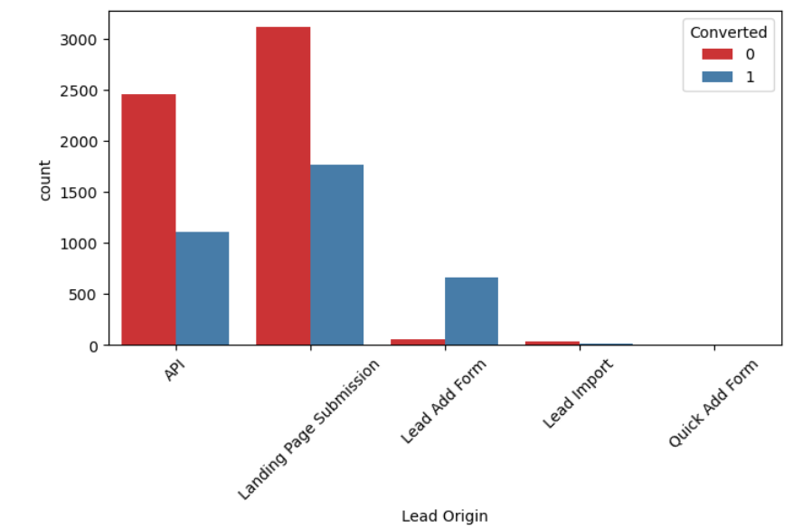
Lead Source has high volume of conversion from Direct Traffic and Google
5
Exploratory Data Analysis
Lead Source has most number of leads originating from ‘Landing Page Submission’

Slide 6
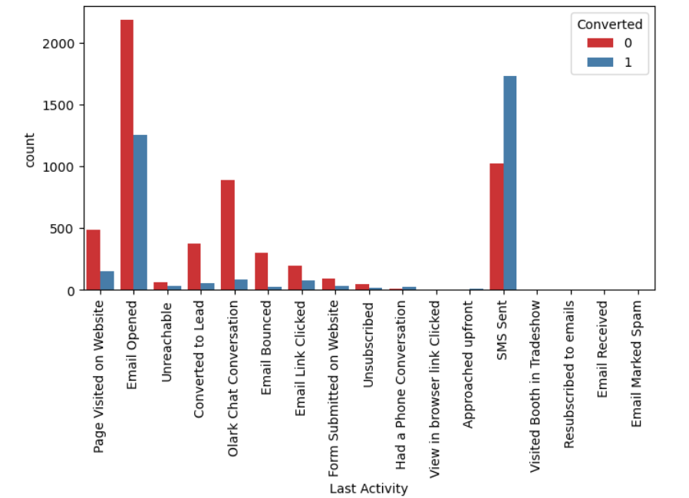
Leads who have ‘Email Opened’ and ‘SMS Sent’ have had highest conversion rate in terms of volume
6
Exploratory Data Analysis

Slide 7
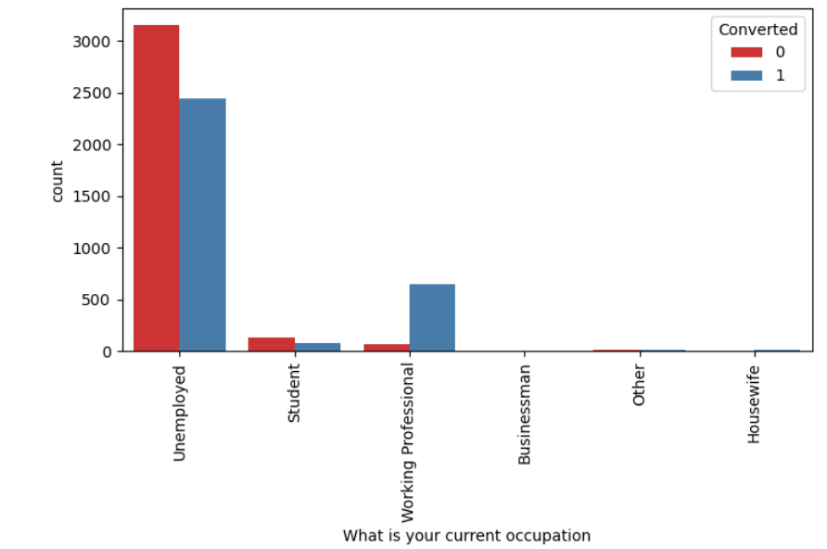
Leads who have ‘Email Opened’ and ‘SMS Sent’ have had highest conversion rate in terms of volume
7
Exploratory Data Analysis
Leads who are ‘Unemployed’ have a high conversion rate possible to increase their marketability as prospective emplooyees

Slide 8
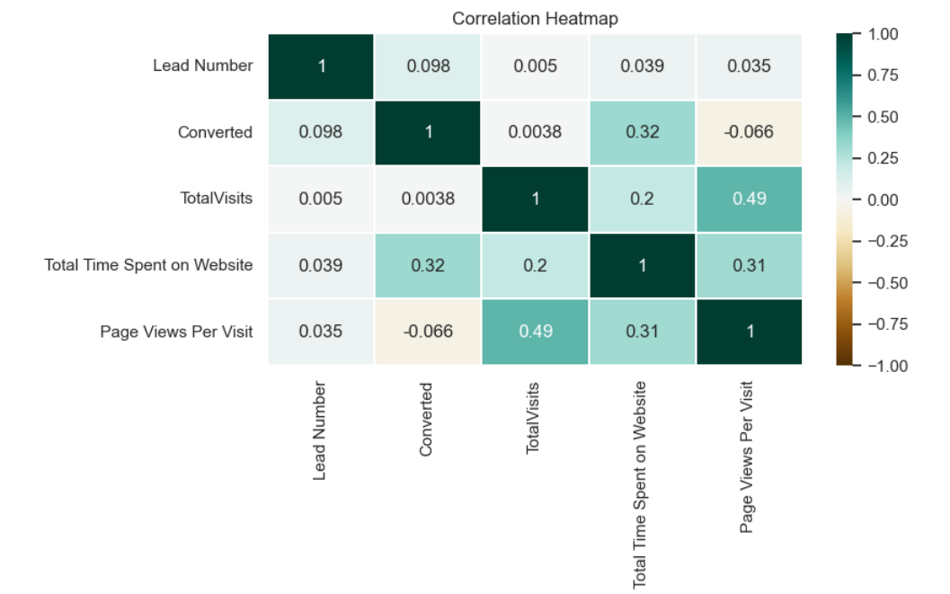
We wanted to check for any relationships between variables using a heatmap and observed that ‘Total Visits ’ and ‘Page Views per Visit’ have a relatively high correlation between them. However, for analysis purpose we’ll use either of the two variables
8
Exploratory Data Analysis

Slide 9
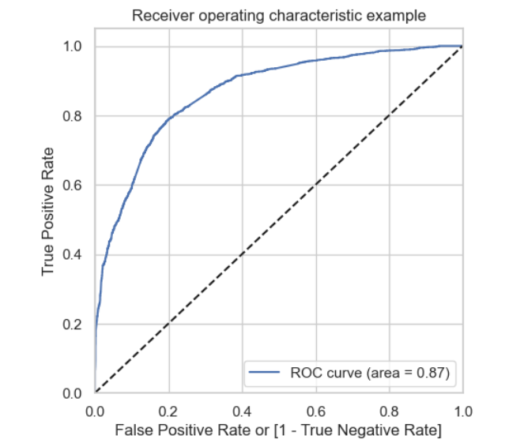
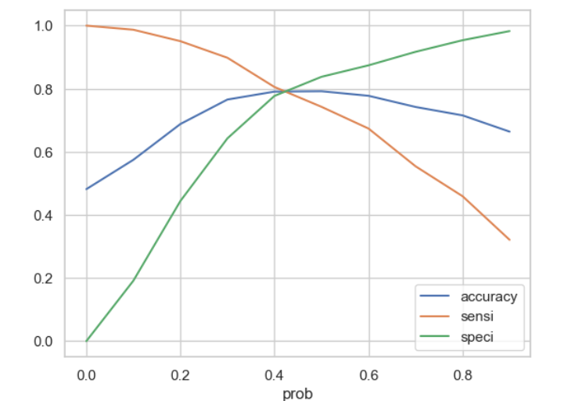
The area under curve of the ROC is at 0.87 which is above 80% and model fit has been decent so far.
9
Model Evaluation
0.42 is the trade-off between Precision and Recall which can be alternatively stated as: consider any Prospect Lead Conversion Probability higher than 42% to be a hit Lead

Slide 10
10
Train data: Accuracy – ~80% (0.7983), Sensitivity – 79%, Specificity – 80%
Test data: Accuracy – 80% , Sensitivity – 79%, Specificity – 80%
List of Features selected
TotalVisits
Total Time Spent on Website
Lead Origin_Lead Add Form
Lead Source_Olark Chat
Lead Source_Welingak Website
Do Not Email_Yes
Last Activity_Had a Phone Conversation
Last Activity_SMS Sent
What is your current occupation_Housewife
What is your current occupation_Student
What is your current occupation_Unemployed
What is your current occupation_Working Professional
Last Notable Activity_Had a Phone Conversation
Last Notable Activity_Modified
Last Notable Activity_Unreachable
Observations

Slide 11
11
The conversion rate for leads generated via API and landing page submissions is around 30–35%, which is considered average. However, the rate is significantly lower for leads obtained through Lead Add forms and Lead imports. This indicates a need to prioritize and enhance lead generation efforts through APIs and landing pages.
The majority of leads come from Google or direct traffic sources. However, the highest conversion rates are observed in leads referred by others or originating from the Welingak website.
Users who spend more time browsing the website show a higher likelihood of conversion.
The most frequent final activity recorded is "Email Opened," while the highest activity rate is observed for "SMS Sent." While most leads are unemployed, the highest conversion rates are seen among working professionals.
Conclusion

